Slide 1

Beginners guide to IOT using a Raspberry Pi
Presented By : The Assembly Team

Slide 2
Introduction
What is Internet Of Things?
A new and emerging concept of connecting any device or appliance to the internet and therefore controlling the way they function. By having sensors embedded into these devices, they can be able to send and receive important data.
Where can this be used?
Home automations
Industrial use
Agricultural use
Healthcare

Slide 3
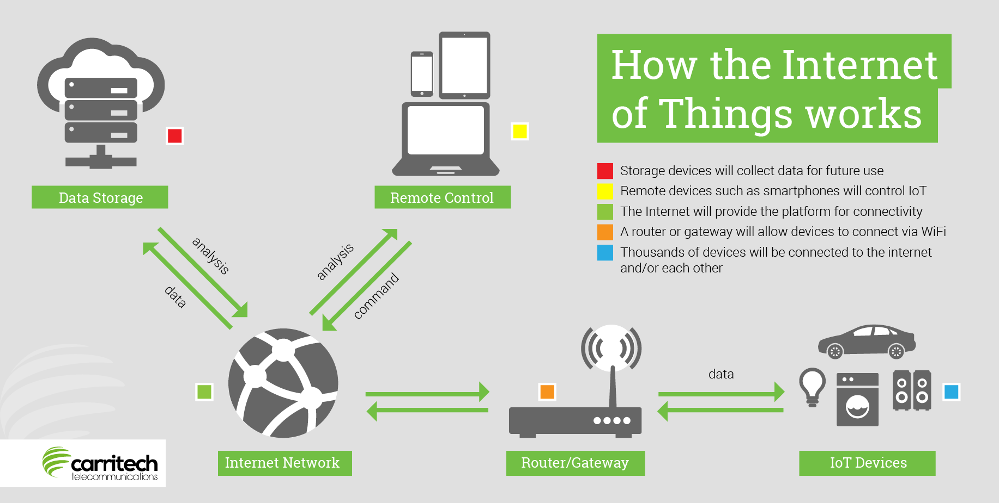
Notes:
Read More https://www.forbes.com/sites/jacobmorgan/2014/05/13/simple-explanation-internet-things-that-anyone-can-understand/#275e12b11d09

Slide 4

What we are going to do today
Data monitoring
Notifications
Controlling

Slide 5
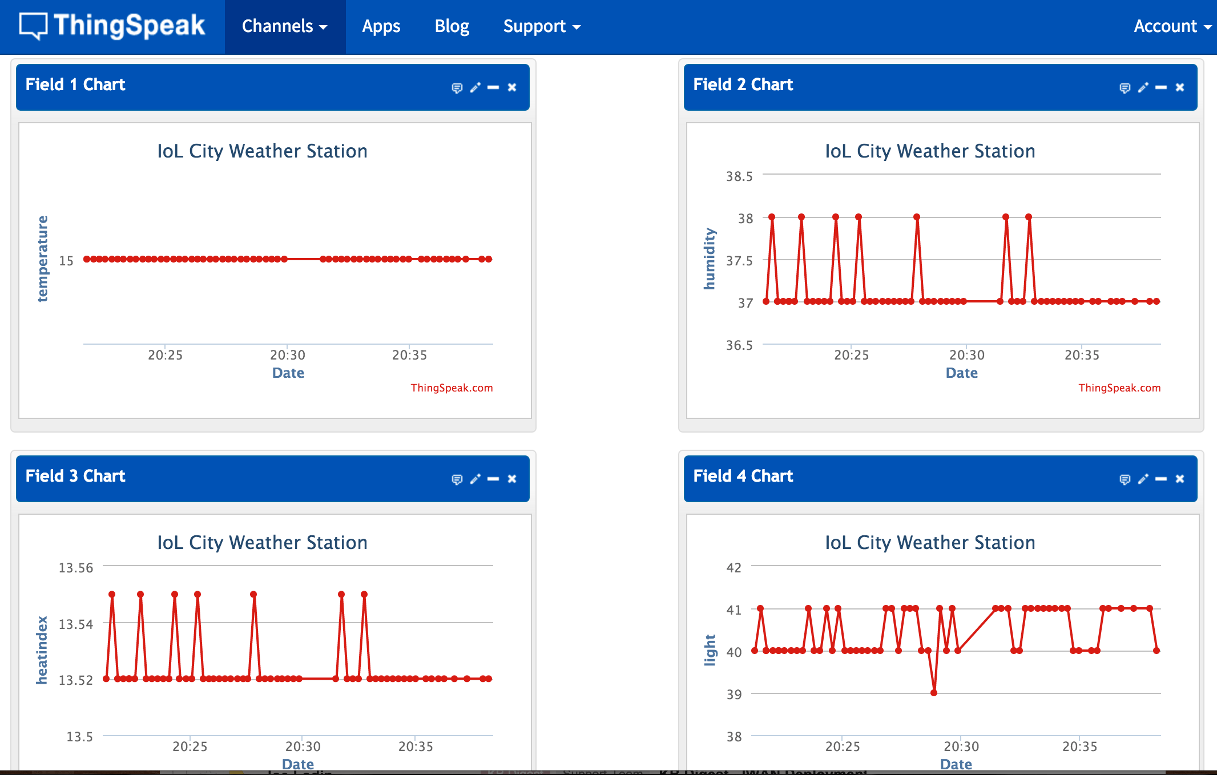
Data monitoring
Will be monitored using ThingSpeak
ThingSpeak is an online application which can be used to monitor sensor data sent through the internet and display it in a graphical format.
In this workshop, we will monitor the following parameters:
Temperature
Motions
Light
Notes:
Read More https://en.wikipedia.org/wiki/ThingSpeak

Slide 6
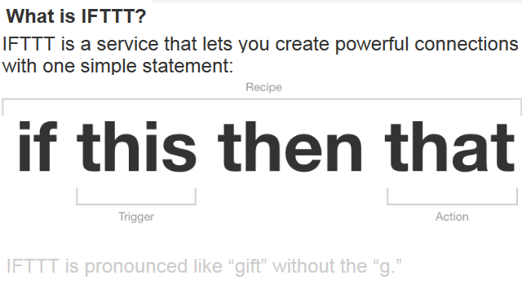
Notifications
Notifications will be triggered using IFTTT (IF This Then That)
In this workshop, we will enable notifications to be sent to our mobile devices using the IFTTT application.
We will trigger notifications for:
Detected motion
If temperature goes beyond a certain value.
If light is detected.
Notes:
Read More https://en.wikipedia.org/wiki/IFTTT

Slide 7
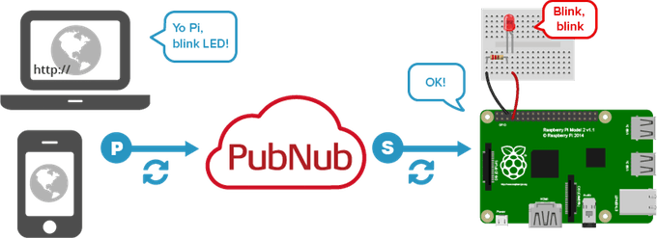
Control
Control of devices through browser can be enabled by Pubnub.
Notes:
Read More https://en.wikipedia.org/wiki/PubNub

Slide 8
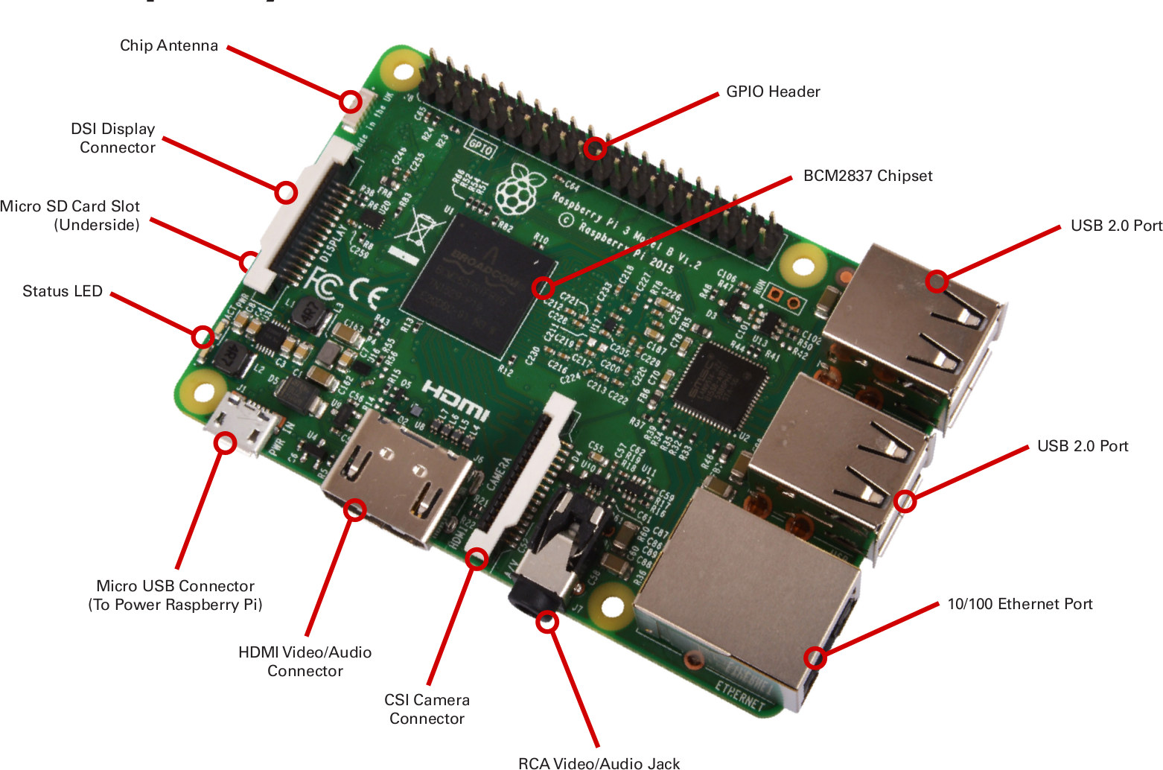
The Raspberry PI
Notes:
Main Website - https://www.raspberrypi.org/
Arduino vs Raspberry PI - https://makezine.com/2015/12/04/admittedly-simplistic-guide-raspberry-pi-vs-arduino/ ; https://circuitdigest.com/article/arduino-vs-raspberryp-pi-difference-between-the-two
Raspberry PI OS - https://lifehacker.com/the-best-operating-systems-for-your-raspberry-pi-projec-1774669829

Slide 9
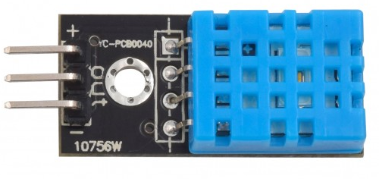
DHT11 - Temp & Humidity Sensor
Measure your surrounding air temperature and relative humidity
Capacitive humidity sensor
Thermistor for temperature sensing
Mounted 10kΩ pull up resistor
Good for 20-80% humidity readings with 5% accuracy
Good for 0-50°C temperature readings ±2°C accuracy
Notes:
Read more https://www.smart-prototyping.com/DHT11-Humidity-and-Temperature-Sensor-Module
Example with Arduino: https://www.smart-prototyping.com/blog/DHT11-Temperature-and-Humidity-Sensor-with-an-Arduino-Uno

Slide 10
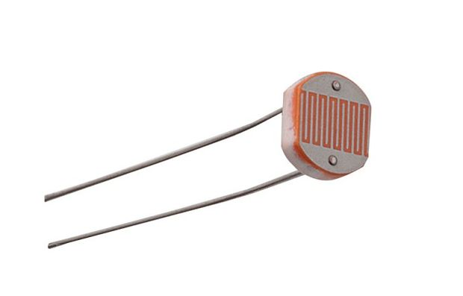
Photoresistor (LDR)
Photo resistors, also known as light dependent resistors (LDR)
Measures the light intensity
In the dark, their resistance is very high, and when exposed to light, the resistance drops dramatically
Variable resistor which varies depending on the intensity of light that fall upon it
Notes:
Read more http://www.resistorguide.com/photoresistor/
https://www.kitronik.co.uk/blog/how-an-ldr-light-dependent-resistor-works/

Slide 11
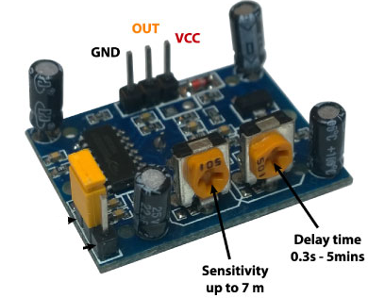
PIR motion sensor
Pyroelectric/ Passive infrared motion sensor
Detect movements/ motion whenever an object in detected in the sensor range
Made up of pyroelectric sensor (round dome), detects levels of infrared radiation.
2 knobs to provide control for the device
Notes:
Read more https://learn.adafruit.com/pir-passive-infrared-proximity-motion-sensor/how-pirs-work

Slide 12
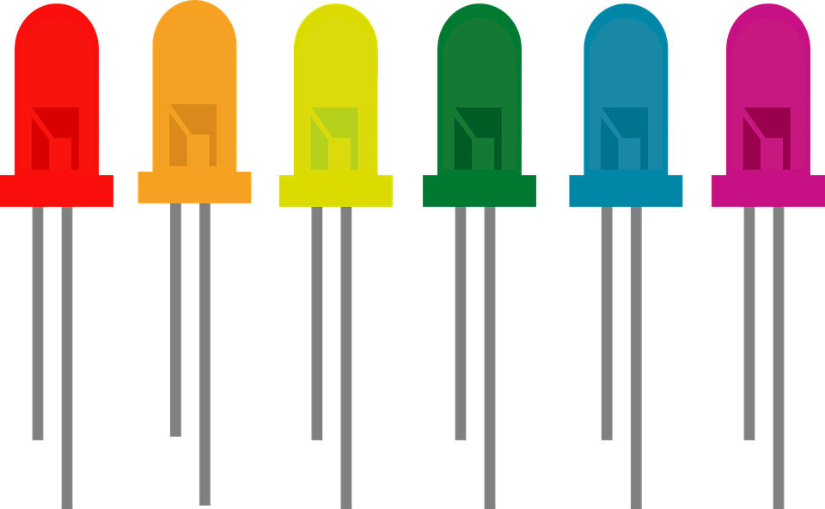
Light Emitted Diode
Light Emitting Diode (LED)
Semi-conductor device
A particular type of diode that convert electrical energy into light.
LEDs are like tiny lightbulbs (require less power)
Energy efficient in comparison
Longer end -> positive end (anode)
Shorter end -> negative end (cathode)
Notes:
*A semiconductor is a substance, usually a solid chemical element or compound, that can conduct electricity under some
conditions but not others, making it a good medium for the control of electrical current.
*The key function of an ideal diode is to control the direction of current-flow. Current passing through a diode can only go in
one direction, called the forward direction.
Read more https://learn.sparkfun.com/tutorials/light-emitting-diodes-leds
http://whatis.techtarget.com/definition/light-emitting-diode-LED

Slide 13
Let’s Begin

Slide 14
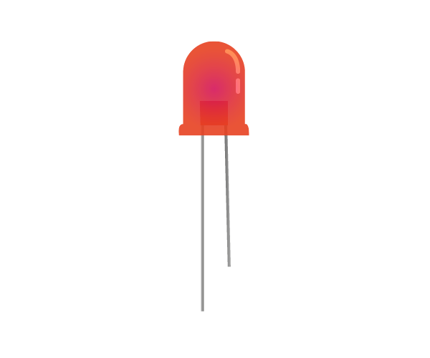


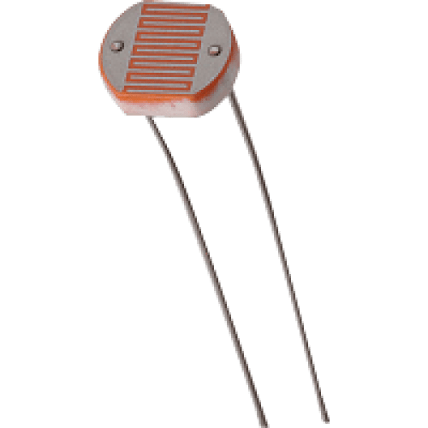
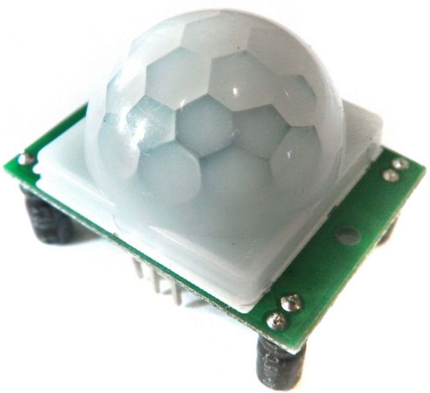
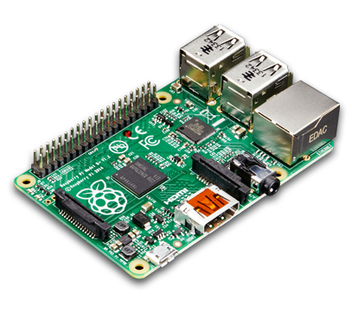
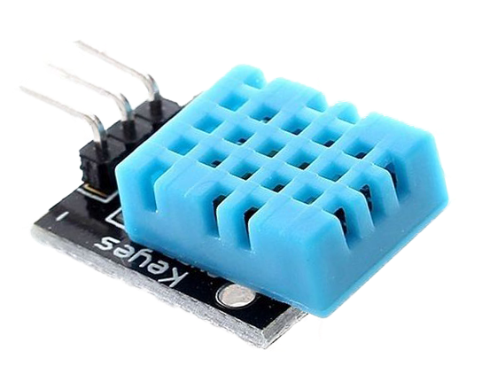

What will we be building

Slide 15
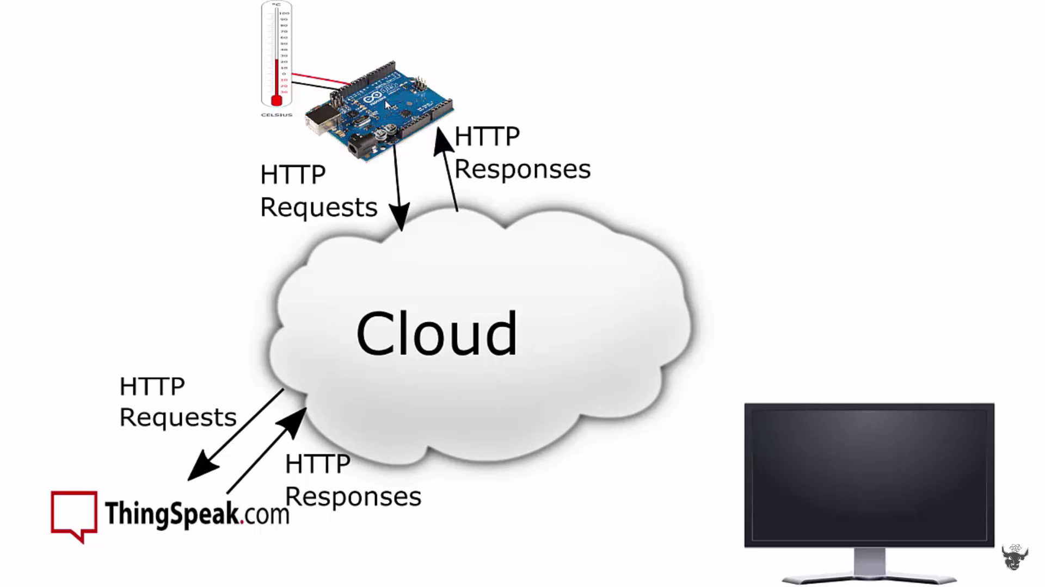
Overview of the Process

Slide 16
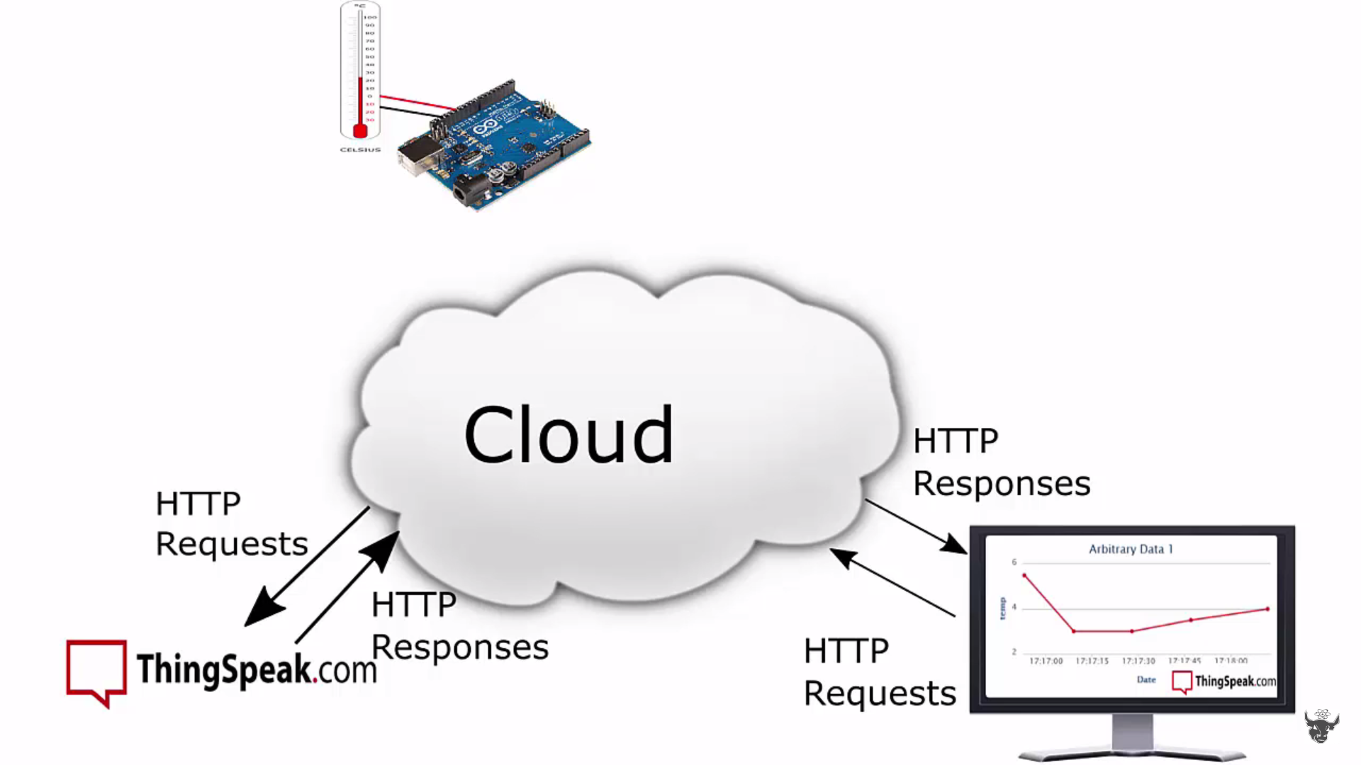
Overview of the Process

Slide 17
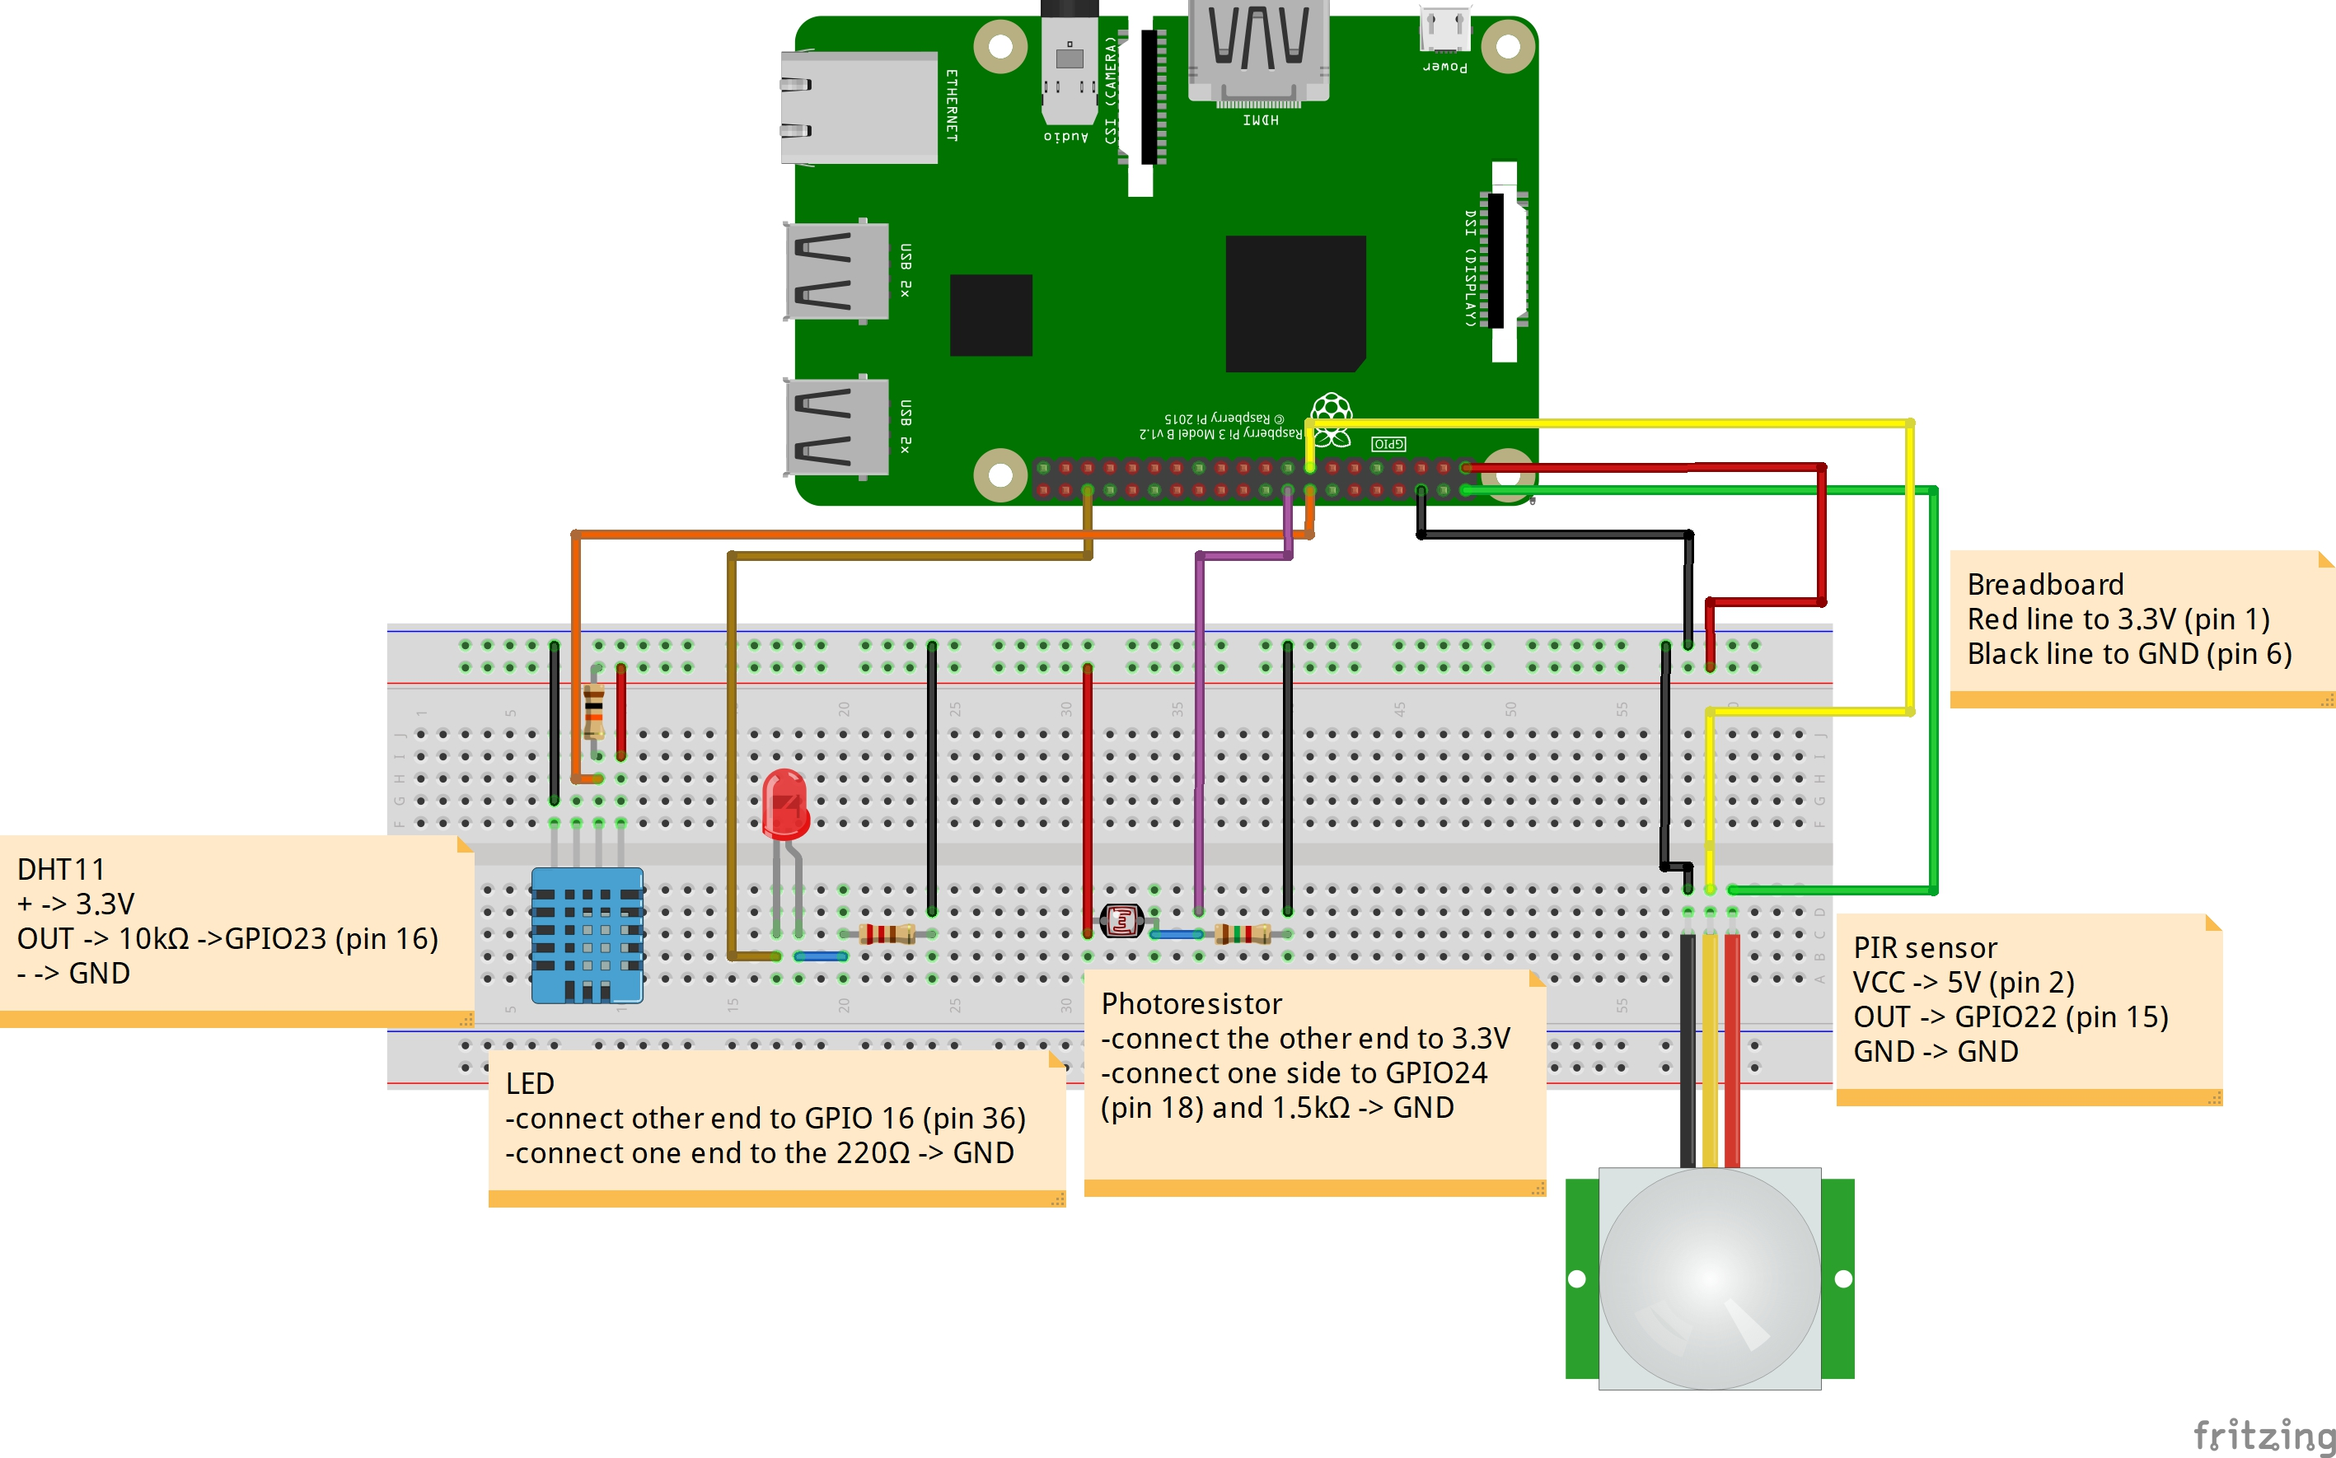
The Circuit Diagram

Slide 18
Code and steps
Install the libraries (on the terminal in Raspberry PI type the following)
Enable RPI.Gpio:
- sudo apt-get update
- sudo apt-get install python-dev
- sudo apt-get install python-dev
- sudo apt-get install mercurial
- sudo apt-get install python-pip
- sudo apt-get remove python-rpi.gpio
- sudo pip install hg+http://hg.code.sf.net/p/raspberry-gpio-python/code#egg=RPi.GPIO

Slide 19
Code and steps
Install Pubnub:
- pip install 'pubnub>=3,<4’
- git clone https://github.com/pubnub/python
Install the Adafruit libraries:
- git clone https://github.com/adafruit/Adafruit_Python_DHT.git
- cd Adafruit_Python_DHT
- sudo apt-get install build-essential python-dev python-openssl
- sudo python setup.py install

Slide 20
Code and steps
Visit https://github.com/The-Assembly/IOT-using-raspberry-PI and download the files
- Thinkspeak : https://thingspeak.com/
- Pubnub : https://www.pubnub.com/?utm_source=PayPerClick&utm_medium=Google-Adwords&utm_campaign=PPC-CY16-Q4-Brand-Google-Adwords-Dec-19&gclid=CjwKCAiArrrQBRBbEiwAH_6sNMqzIj4DZFV4FVu32qaJ5iZN2SSZqmfyogm9_L4UCV5tU4ecYeTKWBoCv7UQAvD_BwE
- IFTTT : https://ifttt.com/discover

Slide 21
Code and steps
Pubnub: To use Pubnub, follow the instructions below
https://www.pubnub.com/?utm_source=PayPerClick&utm_medium=Google-Adwords&utm_campaign=PPC-CY16-Q4-Brand-Google-Adwords-Dec-19&gclid=CjwKCAiArrrQBRBbEiwAH_6sNMqzIj4DZFV4FVu32qaJ5iZN2SSZqmfyogm9_L4UCV5tU4ecYeTKWBoCv7UQAvD_BwE
Create new app
Call it Led control
Press on the app
You will get a demo publish key and subscribe key
On the main code change the publish key and subscribe key to the ones you just generate
Similarly on the html file do the same

Slide 22
Code and steps
Thinkspeak: To use thinkspeak, follow the instruction mentioned below
https://thingspeak.com/
Sign up and make an account on Thinkspeak
Navigate to channels -> New Channel
Name the channel and fill in all the measurement we will be viewing today (Temp_Deg C for channel 1 etc.)
Save the channel
In the private view, now to can see your fields and monitor them
Go the API key and copy the write API key, paste this key on the main code

Slide 23
Code and steps
IFTTT - To use thinkspeak, follow the instruction mentioned below
https://ifttt.com/discover ; Download the app on your phone too
Navigate to my applets -> New applets
Press this and search for Webhooks, give a name for the event
Next press then and search for notification, write a message or leave it as is, Save it.
My Applets -> Services -> webhooks -> settings
Now copy the URL and paste it on your search bar
In the Make a POST or GET web request to write the name of your event
Now copy the link that you generate and put it on the code, now you will receive notification whenever an event is triggered

Slide 24

THANK YOU
THANK YOU

